Slide 1
Managing Social Responsibility and Ethics

Slide 2
Managing Social Responsibility and Ethics
Learning Outcomes
Discuss what it means to be socially responsible and what
factors influence that decision
Explain green management and how organizations can go
green
Discuss the factors that lead to ethical and unethical
behavior
Describe management’s role in encouraging ethical
behavior
Discuss current social responsibility and ethics issues

Slide 3
From Obligation to Responsiveness to Responsibility
Social Obligation - the obligation of a business to meet its economic and legal responsibilities and nothing more.
Social Responsiveness - when a firm engages in social actions in response to some popular social need.
Social Responsibility - a business’s intention, beyond its legal and economic obligations, to do the right things and act in ways that are good for society.

Slide 4
The Classical View
Management’s only social responsibility is to maximize profits (create a financial return) by operating the business in the best interests of the stockholders (owners of the corporation).
Expending the firm’s resources on doing “social good” unjustifiably increases costs that lower profits to the owners and raises prices to consumers.

Slide 5
The Socioeconomic View
Management’s social responsibility goes beyond making profits to include protecting and improving society’s welfare.
Corporations are not independent entities responsible only to stockholders.
Firms have a moral responsibility to larger society to become involved in social, legal, and political issues.
“To do the right thing”

Slide 6
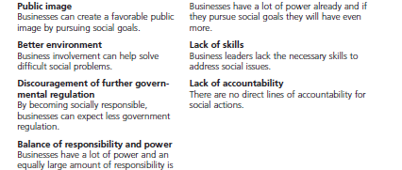
Exhibit 5-1: Arguments For and Against Social
Responsibility

Slide 7

Green Management and Sustainability
Social Screening - applying social criteria (screens) to investment decisions.
Green Management - managers consider the impact of their organization on the natural environment.

Slide 8
How Organizations Go Green
Legal (or Light Green) Approach - firms simply do what is legally required by obeying laws, rules, and regulations willingly and without legal challenge.
Market Approach - firms respond to the preferences of their customers for environmentally friendly products.
Stakeholder Approach - firms work to meet the environmental demands of multiple stakeholders—employees, suppliers, and the community.
Activist Approach - firms look for ways to respect and preserve the environment and be actively socially responsible.

Slide 9
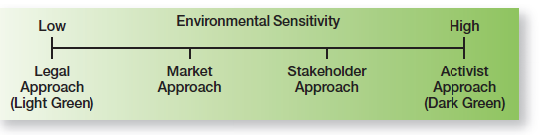
Exhibit 5-2: Green Approaches

Slide 10
Managers and Ethical Behavior
Ethics - principles, values, and beliefs that define right and wrong behavior.
Values - basic convictions about what is right and wrong.

Slide 11
Personality Variables
Ego Strength - a personality measure of the strength of a person’s convictions.
Locus of Control - a personality attribute that measures the degree to which people believe they control their own fate.

Slide 12
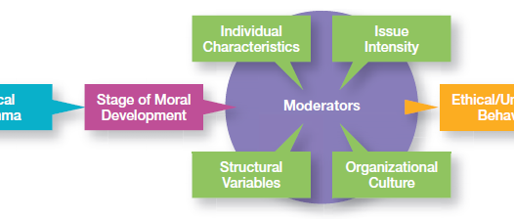
Exhibit 5-3: Factors that Determine Ethical and Unethical Behavior

Slide 13
Moral Development
A measure of independence from outside influences
Levels of Individual Moral Development
  Preconventional level
  Conventional level
  Principled level
Stage of moral development interact with:
  Individual characteristics
  The organization’s structural design
  The organization’s culture
  The intensity of the ethical issue

Slide 14
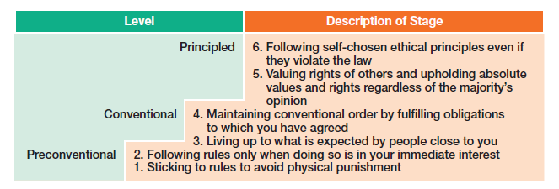
Exhibit 5-4: Stages of Moral Development

Slide 15
Structural Variables
Organizational characteristics and mechanisms that guide and influence individual ethics
Examples include:
  Performance appraisal systems
  Reward allocation systems
  Behaviors (ethical) of managers

Slide 16
Organization’s Culture
Values-Based Management - an approach to managing in which managers establish and uphold an organization’s shared values.
The Purposes of Shared Values
    Guiding managerial decisions
    Shaping employee behavior
    Influencing the direction of marketing efforts
    Building team spirit
The Bottom Line on Shared Corporate Values
    An organization’s values are reflected in the decisions and actions of its employees

Slide 17
Issue Intensity
Characteristics determine issue intensity or how important an ethical issue is to an individual: greatness of harm, consensus of wrong, probability of harm, immediacy of consequences, proximity to victim(s), and concentration of effect.

Slide 18
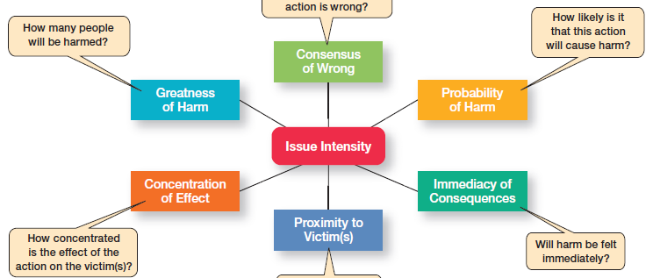
Exhibit 5-5: Ethical Intensity

Slide 19
Ethics in an International Context
Ethical standards are not universal
  Social and cultural differences determine acceptable behaviors.
Foreign Corrupt Practices Act
  It is illegal to corrupt a foreign official, yet “token” payments to officials are permissible when doing so is an accepted practice in that country.

Slide 20
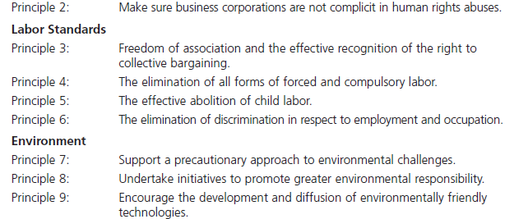
Exhibit 5-6: Ten Principles of the
UN Global Compact

Slide 21
Encouraging Ethical Behavior
Hire individuals with high ethical standards.
Establish codes of ethics and decision rules.
Lead by example.
Set realistic job goals and include ethics in performance appraisals.
Provide ethics training.
Conduct independent social audits.
Provide support for individuals facing ethical dilemmas.

Slide 22
Code of Ethics
Code of Ethics - a formal statement of an organization’s primary values and the ethical rules it expects its employees to follow.

Slide 23
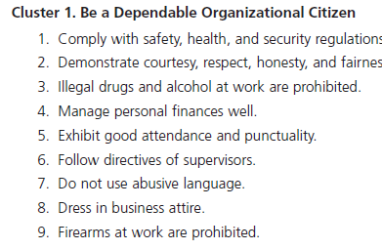
Exhibit 5-7: Code of Ethics

Slide 24
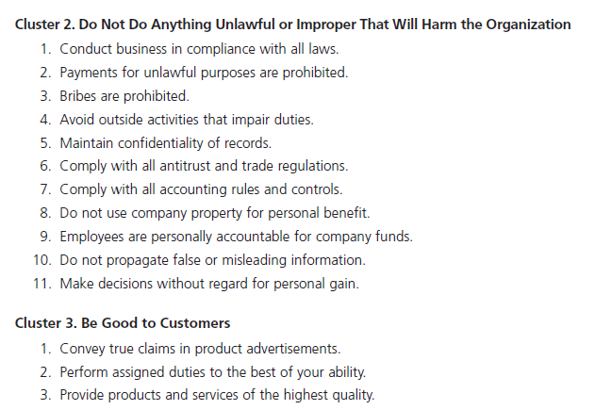
Exhibit 5-7: Code of Ethics (cont.)

Slide 25
The Value of Ethics Training
Can make a difference in ethical behaviors
Increases employee awareness of ethical issues in business decisions
Clarifies and reinforces the organization’s standards of conduct
Helps employees become more confident that they will have the organization’s support when taking unpopular but ethically correct stances

Slide 26
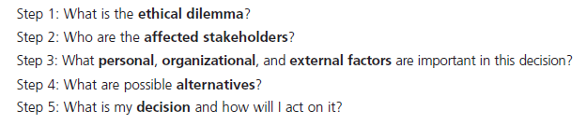
Exhibit 5-8: A Process for Addressing Ethical Dilemmas

Slide 27
Promoting Positive Social Change
Whistle-Blower - individuals who raise ethical concerns or issues to others.
Social Entrepreneur - an individual or organization who seeks out opportunities to improve society by using practical, innovative, and sustainable approaches.

Slide 28
Exhibit 5-9: Becoming an Ethical Leader
Be a good role model by being ethical and honest.
  Tell the truth always.
  Don’t hide or manipulate information.
  Be willing to admit your failures.
Share your personal values by regularly communicating them to employees.
Stress the organization’s or team’s important shared values.
Use the reward system to hold everyone accountable to the values.

Slide 29
Terms to Know
Social obligation
Classical view
Socioeconomic view
Social responsiveness
Social responsibility
Social screening
Green management
Ethics
Values
Ego strength
Locus of control
Values-based management
Code of ethics
Whistle-blower
Social entrepreneur

